Slide 1
Exploring Scalability in Large-Scale Time Series in framework
DeepVATS
Inmaculada Santamaria-Valenzuela
Victor Rodriguez-Fernandez
David Camacho
mi.santamaria@upm.es
13th CONFERENCE ON INFORMATION TECHNOLOGY AND ITS APPLICATIONS | CITA 2024

Slide 2





CITA 2024
Table of contents
Introduction
What is DeepVATS
Scalability Analysis
Conclusions & Future Work

Slide 3
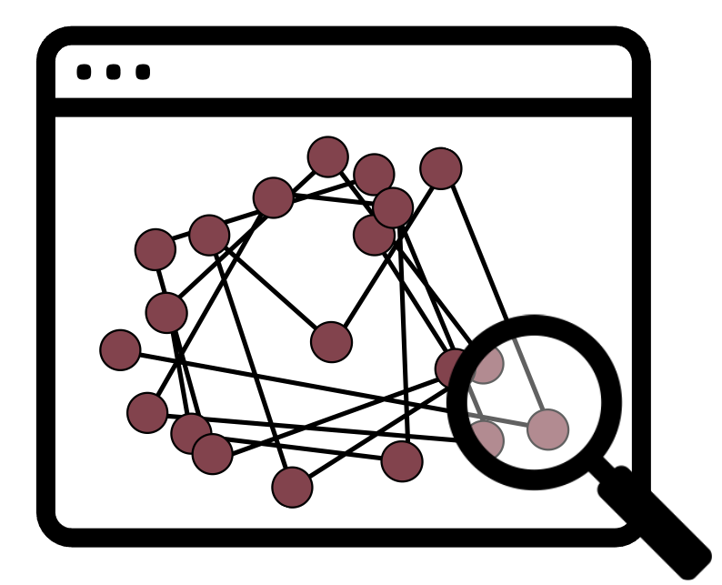
01
Introduction

Slide 4

CITA 2024
1 – Introduction | Objective
We want information:
Patterns?
Anomalies?
Novelets?
Trends?

Slide 5
CITA 2024
1 – Introduction | Technique
We can apply an DL algorithm and check the embeddings

Slide 6
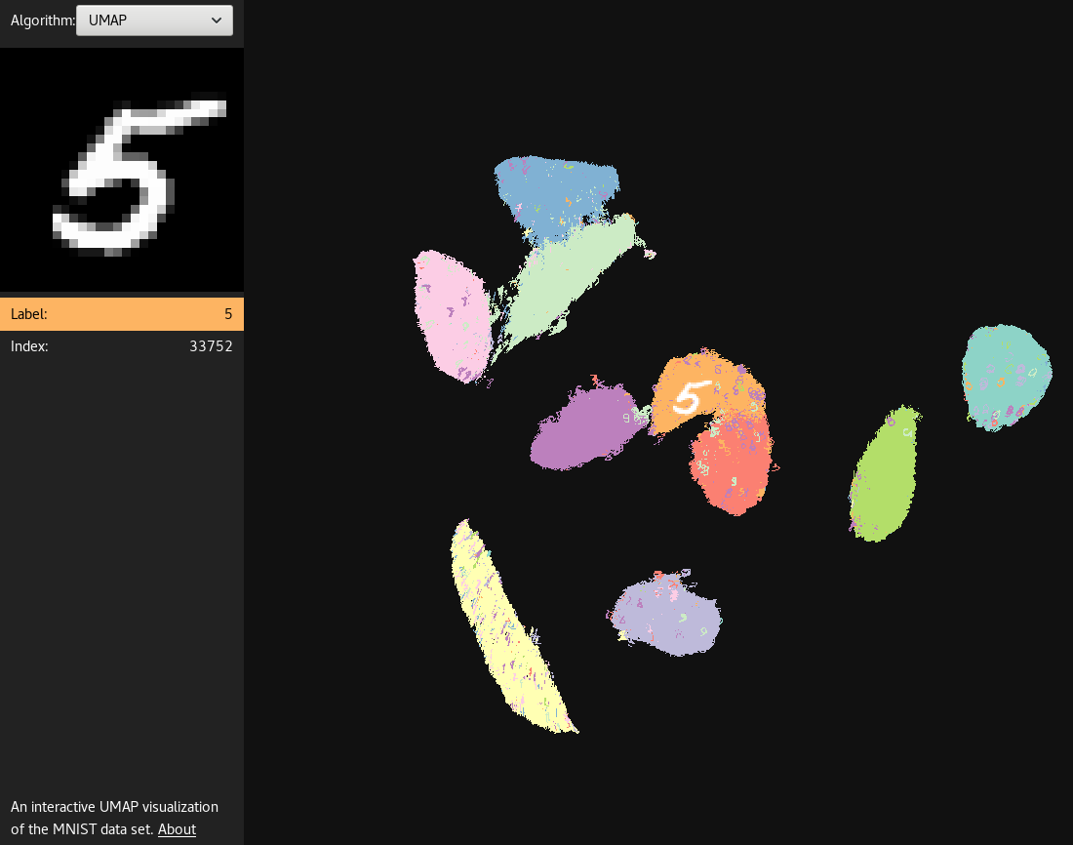
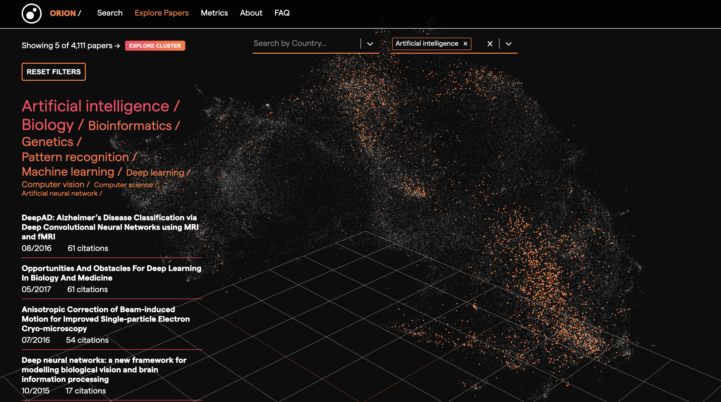

CITA 2024
1 – Introduction | UMAP enhanced clustering | Examples
MNIST digits UMAP’s embeddings
Orion Search

Slide 7
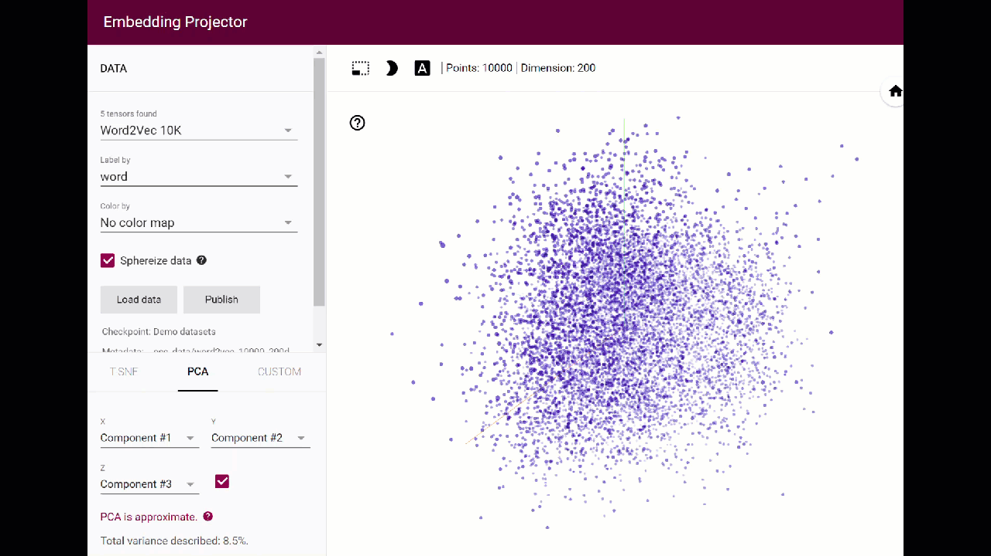


CITA 2024
1 – Introduction | Examples
TensorFlow: embedding projector

Slide 8

02
What is DeepVATS?

Slide 9




CITA 2024
2 – What is DeepVATS | Modules
Deep Learning module
DeepVATS
Storage module
G O A L
Visual and interactive analysis of the embeddings
to detect
Anomalies
Patterns
for making informed decisions
Visual Analytics module

Slide 10

CITA 2024
2 – What is DeepVATS | Modules
G O A L
Main tasks:
Load data
Train Neural Networks (MVP) to get meaningful data representation (embeddings)
Project the embeddings into 2D ( UMAP, TSNE, PCA )
Provide interactive plots to explore different perspectives of the projected embeddings
On large time series
Monash Time Series Forecasting Repository
Solar Power Dataset
( 4 seconds observations )
7 . 497 . 222 ~ 7.4M elements

Slide 11
CITA 2024
Expectations
Load the dataset Train the model Get the embeddings Efficiently interact with the plots
Reality
Load the dataset … backend Train the model … backend Get the embeddings Interact with the plots … with some performance issues
S O ?

Slide 12

03
Scalability Analysis

Slide 13
CITA 2024
3 – Scalability Analysis | A representative dataset
Seconds | Frequency factor | Number of elements
4 | 1 | 7.4 M
8 | 2 | 3,7 M
20 | 5 | 1.5 M
60 | 15 | 493,1 K
300 ( 5 m ) | 75 | 98,6 K
600 (10 m) | 150 | 49,3 K
The largest available…
Monash Time Series Forecasting Repository
Solar Power Dataset
( 4 seconds observations)
7 . 497 . 222 ~ 7.4M elements

Slide 14
CITA 2024
3 – Scalability Analysis | The representative execution steps
Seconds | Factor | Execution time
4 | 1 | Crashes
8 | 2 | 2222289,83791 ~ 617 h
20 | 5 | 1706,99272 ~ 28’
60 | 15 | 883,00638 ~15 min
300 ( 5 m ) | 75 | 240,72486 ~ 4 min
600 (10 m) | 150 | 192,18275 ~ 3 min
* Logarithmic scale *

Slide 15
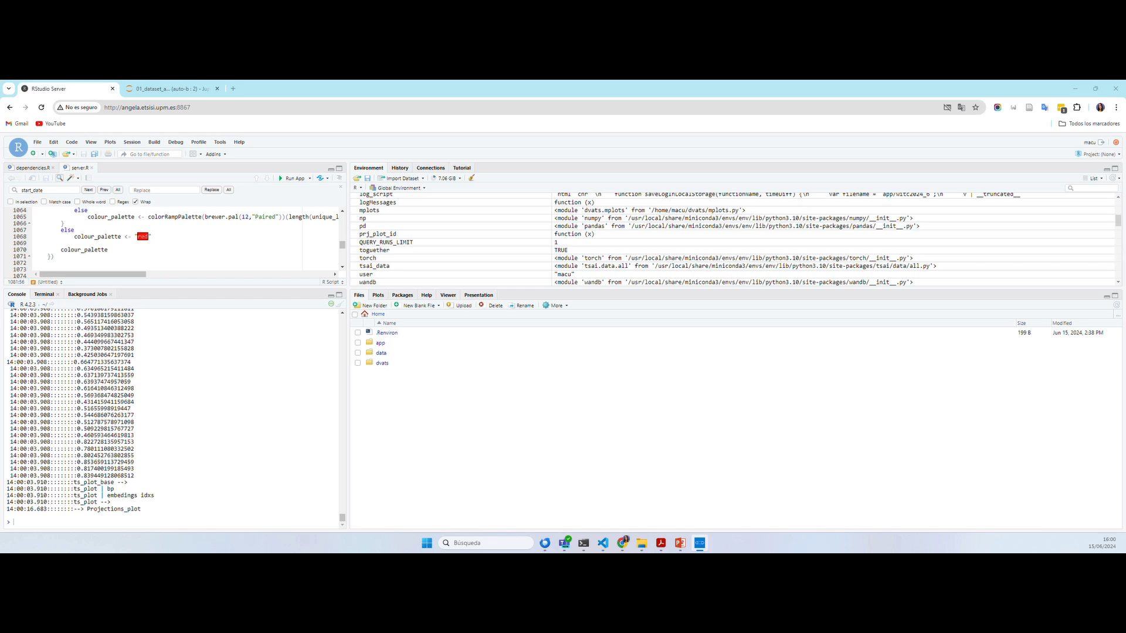
CITA 2024
3 – Scalability Analysis | The representative execution steps

Slide 16
04
Conclusions & future work

Slide 17
CITA 2024
3 – Scalability Analysis | Main problems
GOOD
Powerful tool for VA of univariate and multivariate Time Series
Interaction with embedding projection plot and data plot
=> Concrete knowledge of the embedding space
Efficient for small and medium-size dataset.
WORKED ON
Redundancy
Correct memory management
FUTURE
Ensure the use of cached values
Ensure PP quality using PCA followed by UMAP
And …

Slide 18

05
Near future NEWS!

Slide 19
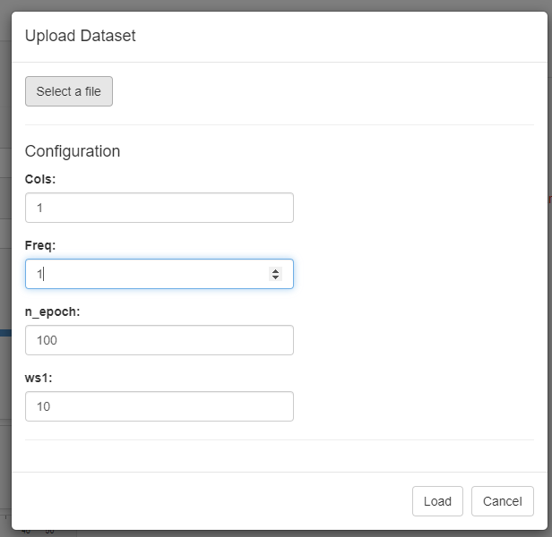
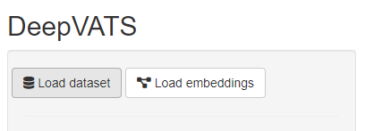
CITA 2024
5 – Near future NEWS | Complete visual flow
Just use the shiny app
Reality
Load the dataset … backend Train the model … backend … …
Forget backend

Slide 20
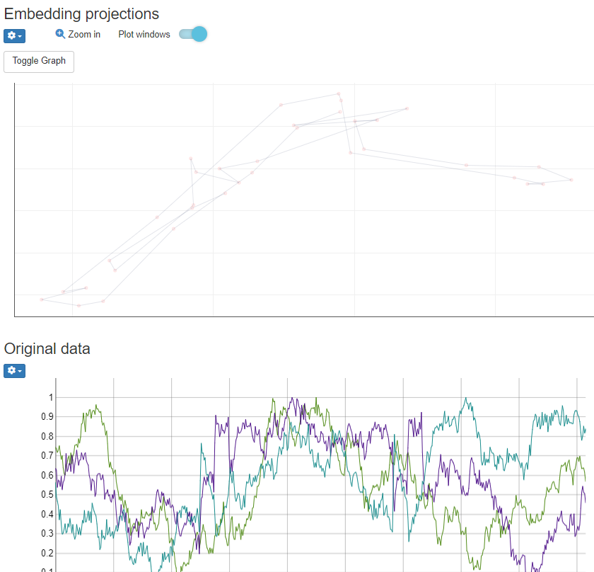
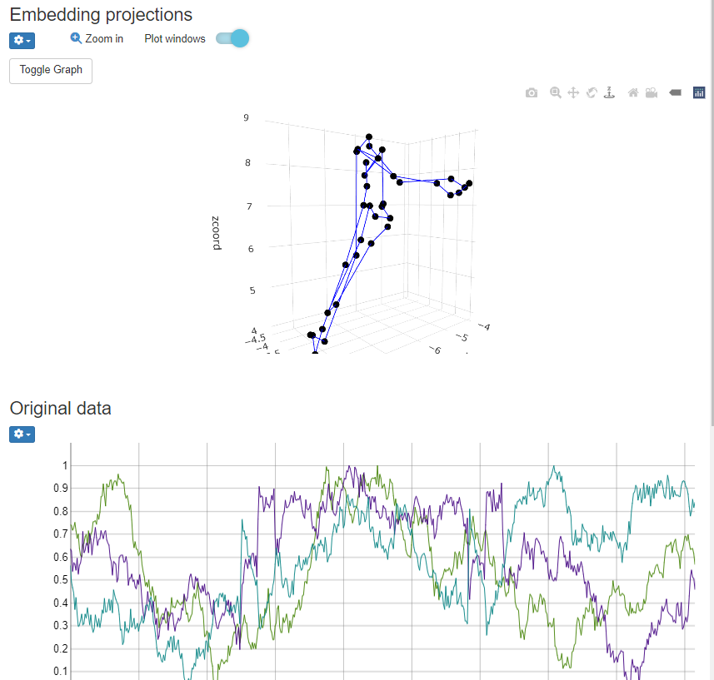
CITA 2024
5 – Near future NEWS | 3D Embeddings plot

Slide 21
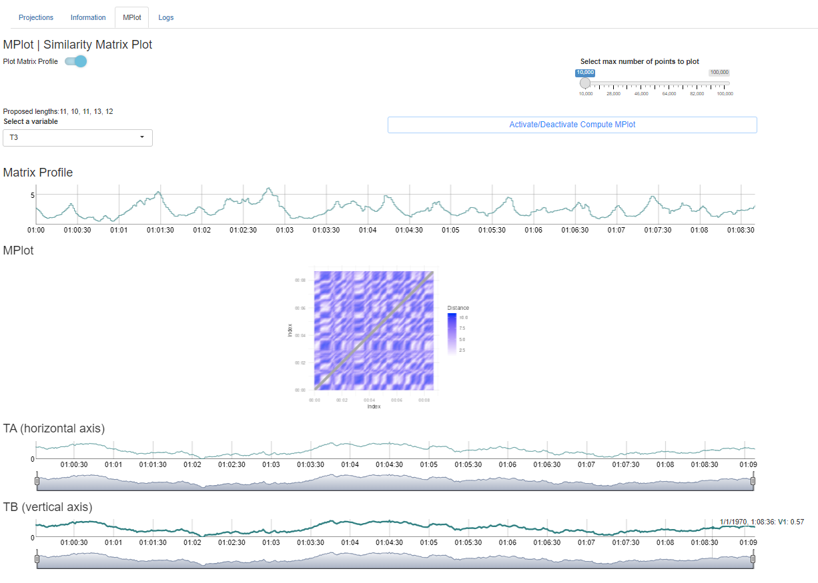


CITA 2024
5 – Near future NEWS | Automatic window selection
F O U R I E R T R A N S F O R M
“A simple, yet effective method for choosing the window size is the dominant frequency of the Fourier Transform”
ClaSP Fourier
M – TOY

Slide 22
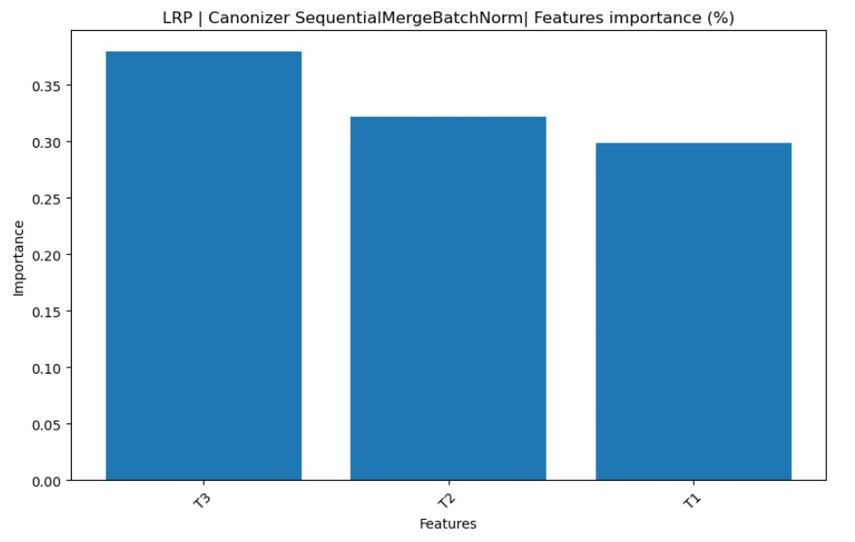
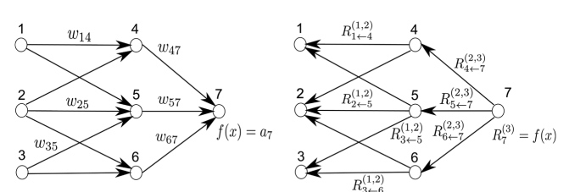

CITA 2024
5 – Near future NEWS | Layer-wise Relevance Propagation | Automatic variable selection
L A Y E R – WISE RELEVANCE PROPAGATION
M – T O Y

Slide 23

CITA 2024
5 – Near future NEWS | Backend enhanced flow

Slide 24

CITA 2024
5 – Near future NEWS | New Visual Analytics Tools: MPlots

Slide 25
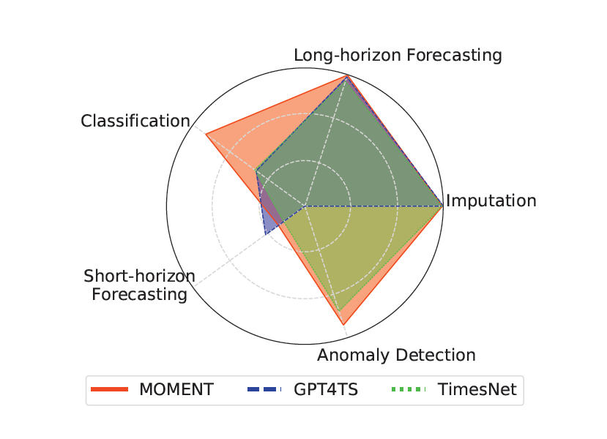

CITA 2024
5 – Near future NEWS | New models | Foundation models
F O U N D A T I O N M O D E L S
Family of open-source large pre-trained time series models
Diverse time series tasks
Effective out-of-the-box
zero-shot forecasting
few-shot classification
Tunable
MOMENT

Slide 26
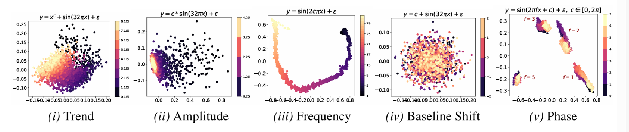
CITA 2024
5 – Near future NEWS | New models | Foundation models

Slide 27
Thanks
Any questions?
mi.santamaria@upm.es

Slide 28
Exploring Scalability in Large-Scale Time Series in DeepVATS framework
Inmaculada Santamaria-Valenzuela
Victor Rodriguez-Fernandez
David Fernandez-Camacho
mi.santamaria@upm.es
13th CONFERENCE ON INFORMATION TECHNOLOGY AND ITS APPLICATIONS | CITA 2024

